Slide 1
VI. Reciprocal lattice
6-1. Definition of reciprocal lattice from a lattice
with periodicities in real space
Remind what we have learned in chapter 5
Pattern → Fourier transform → diffraction
Pattern of the original pattern!

Slide 2
3-D: the Fourier transform of a function f(x,y,z)
Note that
ux+vy+wz: can be considered as a scalar
product of
if the following conditions are met!
What is ?
Then what is ?

Slide 3
Consider the requirements for the basic
translation vectors of the “reciprocal lattice”
Say
i.e.
In other words,

Slide 4
Similarly,
＊ A translation vector in reciprocal lattice is
called reciprocal lattice vector
* orthogonality; orthornormal set

Slide 5
* In orthorhombic, tetragonal and cubic
systems,
* is perpendicular to the plane (h, k, l) in
real space
C
B
A
The reciprocal lattice vector

Slide 6
C
B
A
Similarly,
Therefore,
is perpendicular to the plane (h, k, l)

Slide 7
Moreover,
interplanar spacing
of the plane (h, k, l)
C
B
A
or
or

Slide 8
Graphical view of reciprocal lattice!

Slide 9
♦ How to construct a reciprocal lattice from a crystal
Pick a set of planes in a crystal and using a direction
and a magnitude to represent the plane
parallel
Plane
set 2
d₂
d₁
Plane set 1
Does it really form a
lattice?
Draw it to convince
yourself!
Plane
set 3
d₃

Slide 10
Example: a monoclinic crystal
Reciprocal lattice (a* and c*) on the plane
containing a and c vectors.
(b is out of the plane)
c
b
a
(-100)
(100)
(001)
c
(001)
c
(102)
(002)
(002)
β
O
O
a
O
a
(00-2)
c
(00-2)
(002)
O
c
a
(001)
(101)
c
c*
(002)
β
β*
(002)
O
β
a*
a
(10-1)
(00-1)
a
(00-2)
2D →form a 3-D reciprocal lattice

Slide 11
Lattice point in reciprocal space
Integer
Lattice points in real space

Slide 12
Relationships between a, b, c and a*, b*, c*:
Monoclinic: plane ⊥ y-axis (b)
φ: c ∧ c*.
c
φ
Similarly,
c*
b
d₀₀₁
a
c⋅c* = |c*|ccosφ, |c*| = 1/d₀₀₁ → ccosφ = d₀₀₁
→ c⋅c* = 1

Slide 13
Similarly, a⋅a* = 1 and b⋅b* =1.
c* //a×b,
Define c* = k (a×b), k : a constant.
c⋅c* = 1 → c⋅k(a×b) = 1 → k = 1/[c⋅(a×b)]=1/V.
V: volume of the unit cell
→
Similarly, one gets

Slide 14
6-2. Reciprocal lattices corresponding to crystal
systems in real space
(i) Orthorhombic ,tetragonal ,cubic
(ii) Monoclinic
γ
γ*

Slide 15
(iii) Hexagonal
120º
30º
60º
30º
60º
We deal with reciprocal lattice
Transformation in Miller indices.

Slide 16
: unit vector of
: unit vector of

Slide 17
6-3. Interplanar spacing
(i) for cubic ,orthorhombic, tetragonal systems

Slide 18
Similarly,
(ii) for the hexagonal system

Slide 21
6-4. Angle between planes (h₁k₁l₁) and (h₂k₂l₂)
for the cubic system

Slide 22
6-5. The relationship between real lattice and
reciprocal lattice in cubic system：
Real lattice Reciprocal lattice
Simple cubic Simple cubic
BCC FCC
FCC BCC

Slide 23
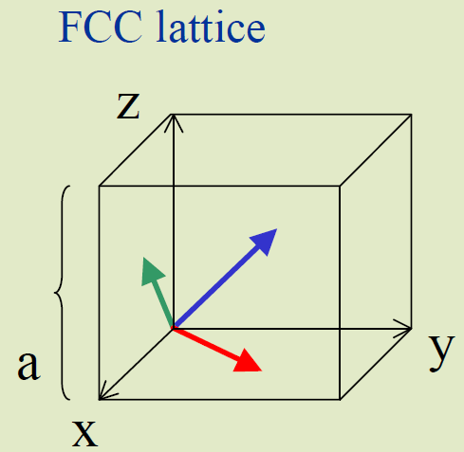
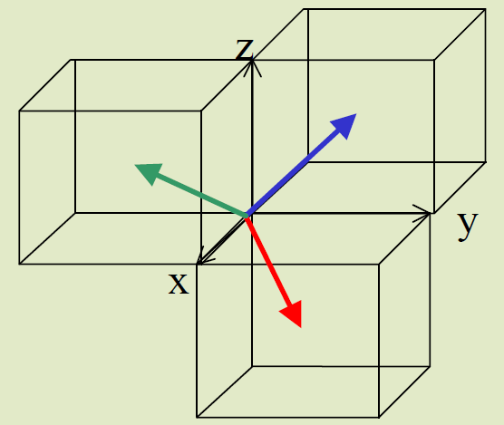
Example：f.c.c b.c.c
(1) Find the primitive unit cell of the selected
structure
(2) Identify the unit vectors

Slide 24
Volume of F.C.C. is a³. There are four atoms
per unit cell! → the volume for the primitive
of a F.C.C. structure is ?

Slide 25
Similarly,
→ B.C.C.
See page 23

Slide 26
Here we use primitive cell translation vector to
calculate the reciprocal lattice.
When we are calculating the interplanar spacing,
the reciprocal lattices that we chosen is different.
Contradictory?
Which one is correct?

Slide 27
Using primitive translation vector to do the
reciprocal lattice calculation:
Case: FCC → BCC

Slide 29
not
Why?
(hkl) defined using unit cell!
(hkl) is defined using primitive cell!
(HKL)

Slide 30
Example
• Find out the relation between the (hkl) and
[uvw] in the unit cell defined by and the
(HKL) and [UVW] in the unit cell defined by
.
In terms of matrix

Slide 31
Find out the relation between (hkl) and (HKL).
Assume there is the first plane
intersecting the a axis at
a/h and the b axis at b/k.
In the length of |a|, there
are h planes. In the length
of |b|, there are k planes.
How many planes can
be inserted in the length
|A|? Ans. h + 2k
→ H = 1h + 2k + 0l
Similarly, K = -1h + 1k +0l and L = 0h + 0k + 1l
A
B
b
2k
a
b/k
a/h
h
A/(h+2k)
or

Slide 33
There are the same!
Or

Slide 34
We proof the other way around!

